Slide 1

Citizenship in the World
Troop 344 and 9344
Pemberville, OH

Slide 2

Citizenship in the World
Merit Badge Requirements
Explain what citizenship in the world means to you and what you think it takes to be a good world citizen.
Explain how one becomes a citizen in the United States, and explain the rights, duties, and obligations of U.S. citizenship. Discuss the similarities and differences between the rights, duties, and obligations of U.S. citizens and the citizens of two other countries.
Do the following:
  Pick a current world event. In relation to this current event, discuss with your counselor how a country's national interest and its relationship with other countries might affect areas such as" its security, its economy, its values, and the health of its citizens.
  Select a foreign country and discuss with your counselor how its geography, natural resources, and climate influence its economy and its global partnerships with other countries.

Slide 3

Citizenship in the World
Merit Badge Requirements
Do TWO of the following:
  Explain international law and how it differs from national law. Explain the role of international law and how international law can be used as a tool for conflict resolution.
  Using resources such as major daily newspapers, the Internet (with your parent's permission), and news magazines, observe a current issue that involves international trade, foreign exchange, balance of payments, tariffs, and free trade. Explain what you have learned. Include in your discussion an explanation of why countries must cooperate in order for world trade and global competition to thrive.
  Select TWO of the following organizations and describe their role in the world.
    The United Nations and UNICEF
    The World Court
    Interpol
    World Organization of the Scout Movement
    The World Health Organization
    Amnesty International
    The International Committee of the Red Cross
    CARE (Cooperative for American Relief Everywhere)
    European Union

Slide 4
Citizenship in the World
Merit Badge Requirements
Do the following:
  Discuss the differences between constitutional and nonconstitutional governments.
  Name at least five different types of governments currently in power in the world.
  Show on a world map countries that use each of these five different forms of government.
Do the following:
  Explain how a government is represented abroad and how the United States government is accredited to international organizations.
  Describe the roles of the following in the conduct of foreign relations.
    Ambassador
    Consul
    Bureau of International Information Programs
    Agency for International Development
    United States and Foreign Commercial Service
  Explain the purpose of a passport and visa for international travel.

Slide 5
Citizenship in the World
Merit Badge Requirements
Do TWO of the following (with your parent's permission) and share with your counselor what you have learned:
  Visit the website of the U.S. State Department. Learn more about an issue you find interesting that is discussed on this website.
  Visit the website of an international news organization or foreign government, OR examine a foreign newspaper available at your local library, bookstore, or newsstand. Find a news story about a human right realized in the United States that is not recognized in another country.
  Visit with a student or Scout from another country and discuss the typical values, holidays, ethnic foods, and traditions practiced or enjoyed there.
  Attend a world Scout jamboree.
  Participate in or attend an international event in your area, such as an ethnic festival, concert, or play.

Slide 6

Requirement 1
Explain what citizenship in the world means to you and what you think it takes to be a good world citizen.

Slide 7
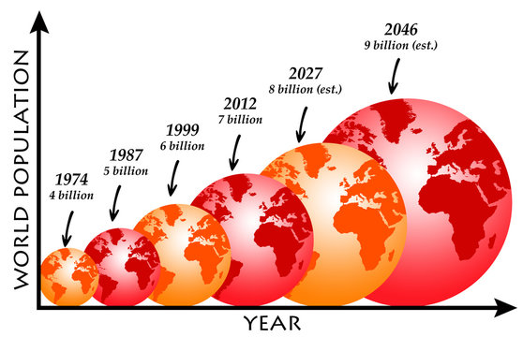
Citizenship in the World
What is Citizenship in the World
  What does this even have to do with Scouting?
    We all live in and share the same world.
    There are more than 8 billion of use sharing this space.
    Our part of the world may be different that other parts.
    But most of us share the same goals in life.

Slide 8
Citizenship in the World
Explain what citizenship in the world means to you and what you think it takes to be a good world citizen.
  You will need to answer this yourself.
  There are many acceptable answers.
  “I don’t know” is not one of them!!

Slide 9

Citizenship in the World
You were born on earth and are by default a citizen of this world.
This Citizenship in this large community comes with:
  Privileges.
  Freedoms.
  Duties.

Slide 10
Citizenship in the World
What is your responsibility to the world?
  To make the world a better place for all?
  To do my part in saving the environment?
  Find better ways for people to coexist?
  Avoid wars?
  Protect human rights?
  Help others practice the religion they want to practice?
  Discover a way to make a better chocolate?

Slide 11
Requirement 2
Explain how one becomes a citizen in the United States, and explain the rights, duties, and obligations of U.S. citizenship. Discuss the similarities and differences between the rights, duties, and obligations of U.S. citizens and the citizens of two other countries.

Slide 12
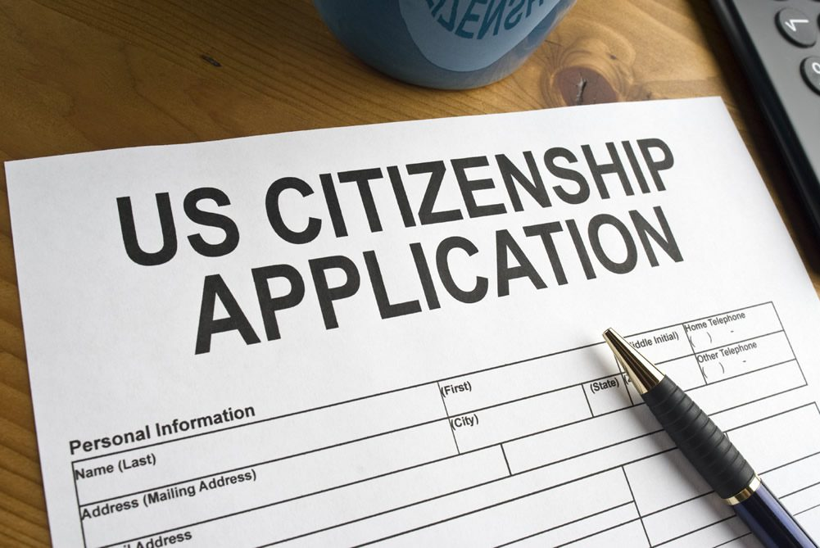
How to Become a U.S. Citizen
US Citizenship
  How one becomes a citizen in the United States.
    You were born in the United States or a territory of the United States.
    At least one of your parents a U.S. citizen.
    You may qualify for naturalization if you:
      are at least 18 years.
      are a permanent resident for at least 5 years (or 3 years if you are married to a U.S. citizen).
      prepare and Submit an Application for Naturalization.
      submit biometrics for FBI background check.
      complete the interview.
        Pass English test.
        Pass Civics test.
      take the Oath of Allegiance to the United States.

Slide 13
Rights, Duties, and Obligations of U.S. Citizenship
US Citizenship Rights:
  Freedom of speech and expression.
  Freedom to worship as you wish.
  Right to a prompt, fair trial by jury.
  Right to vote in elections for public officials.
  Right to apply for federal employment .requiring U.S. citizenship.
  Right to run for elected office.
  Freedom to pursue “life, liberty, and the pursuit of happiness”.

Slide 14
Rights, Duties, and Obligations of U.S. Citizenship
US Citizenship Duties:
  Making yourself aware of all federal, state, and local laws.
  Following all laws and regulations in good faith.
  If you witness any crimes, reporting what you’ve seen to the authorities.
  Serve on a jury when called upon.
  Paying all of your taxes honestly and in a timely manner.
  Defend the country if the need should arise.
  Voting in local, state, and federal elections to strengthen our democracy.

Slide 15
Rights, Duties, and Obligations of U.S. Citizenship
US Citizenship Obligations:
  Support and defend the U.S. Constitution.
  Stay informed of the issues affecting your community.
  Participate in the democratic process.
  Respect and obey federal, state, and local laws.
  Respect the rights, beliefs, and opinions of others.
  Participate in your local community.

Slide 16
Citizenship in Other Countries
 | Freedom Speech | Freedom Worship | Trial by Jury | Vote for Top Leaders | Government Healthcare | Protection against gender discrimination | Protection against racial discrimination | Name your kid whatever | Unlimited access to WWW | Disabilities protection | Vote | Mandatory Conscription | Military Service | Pay Taxes | Serve on Jury
USA | Y | Y | Y | Y | N | Y | Y | Y | Y | Y | Y | N | Y | Y | Y
UK | Y | Y | Y | Y | Y | Y | Y | Y | Y | Y | Y | N | Y | Y | Y
Germany | Y | Y | N | Y | Y | Y | Y | N | Y | Y | Y | N | Y | Y | N
China | N | N | N | N | N | N | N | N | N | YN | N | N | Y | Y | YN

Slide 17
Requirement 3
Do the following:
  Pick a current world event. In relation to this current event, discuss with your counselor how a country's national interest and its relationship with other countries might affect areas such as" its security, its economy, its values, and the health of its citizens.
  Select a foreign country and discuss with your counselor how its geography, natural resources, and climate influence its economy and its global partnerships with other countries.

Slide 18
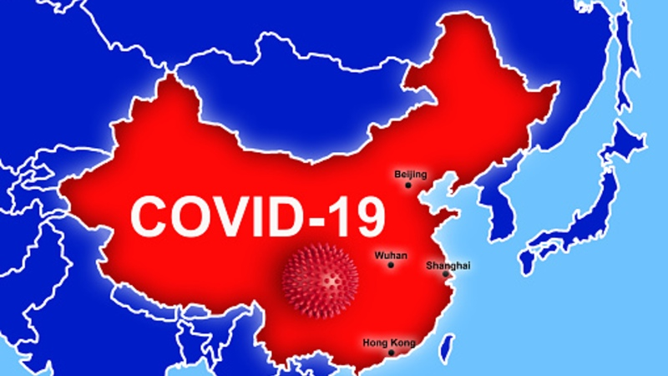
Current World Event
Covid 19
Thought to originate in Wuhan, China.
Concern that China may not have shared timely or accurate data.
Widespread global implications:
  Health concerns.
  Security concerns.
  Economic concerns.
  National and individual values:
    Political.
    Racial.

Slide 19
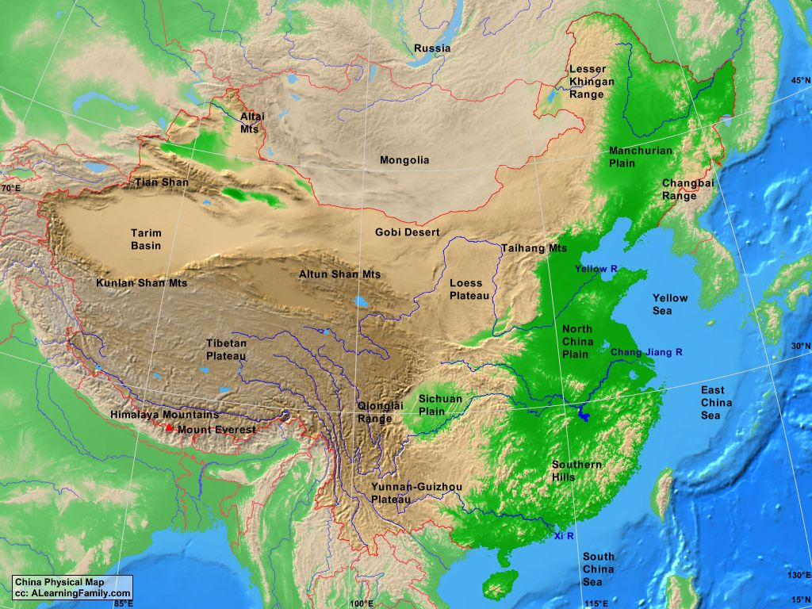
Current World Event
China and Its Economy
Geography
  Coastlines
  Fertile land
  Rivers
  Deserts
  Mountains

Slide 20
Current World Event
Climate
Eastern half of China influenced by monsoons.
  Cold and dry in winter.
  Warm and rainy climate in summer.
Northwestern China is arid desert.
Southwestern China mountains.
Cold temperature northern regions.
Hot southern tropical regions.

Slide 21
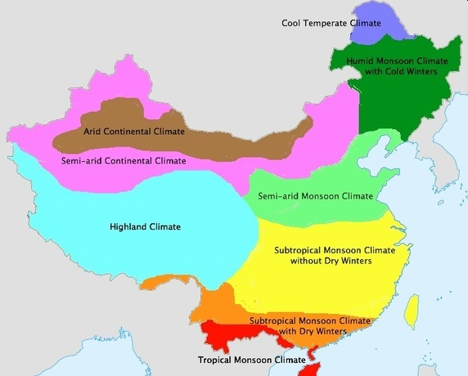
Current World Event
China Climate

Slide 22
Current World Event
China and Its Economy
Natural resources:
  World’s top mining country.
  Rivers for hydroelectric power.
  Human labor.
  Rare earth metals.
  Number one in global agriculture.

Slide 23
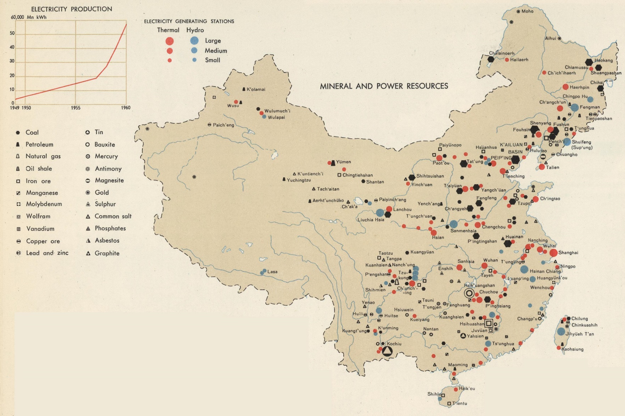
Current World Event
China Natural Resources

Slide 24
Requirement 4
Do TWO of the following:
  Explain international law and how it differs from national law. Explain the role of international law and how international law can be used as a tool for conflict resolution.
  Using resources such as major daily newspapers, the Internet (with your parent's permission), and news magazines, observe a current issue that involves international trade, foreign exchange, balance of payments, tariffs, and free trade. Explain what you have learned. Include in your discussion an explanation of why countries must cooperate in order for world trade and global competition to thrive.
  Select TWO of the following organizations and describe their role in the world.
    The United Nations and UNICEF
    The World Court
    Interpol
    World Organization of the Scout Movement
    The World Health Organization
    Amnesty International
    The International Committee of the Red Cross
    CARE (Cooperative for American Relief Everywhere)
    European Union

Slide 25
International Law
4a. Explain international law and how it differs from national law. Explain the role of international law and how international law can be used as a tool for conflict resolution.

Slide 26
International Law
There are around 200 independent nations in this world.
  193 member states in UN.
  2 observer states in UN.
  Taiwan – not recognized by many countries or the UN due to pressure from China.
  Dozens of territories, colonies and non-recognized nations.
    Puerto Rico
    Bermuda
    Greenland
    Palestine
    Western Sahara

Slide 27
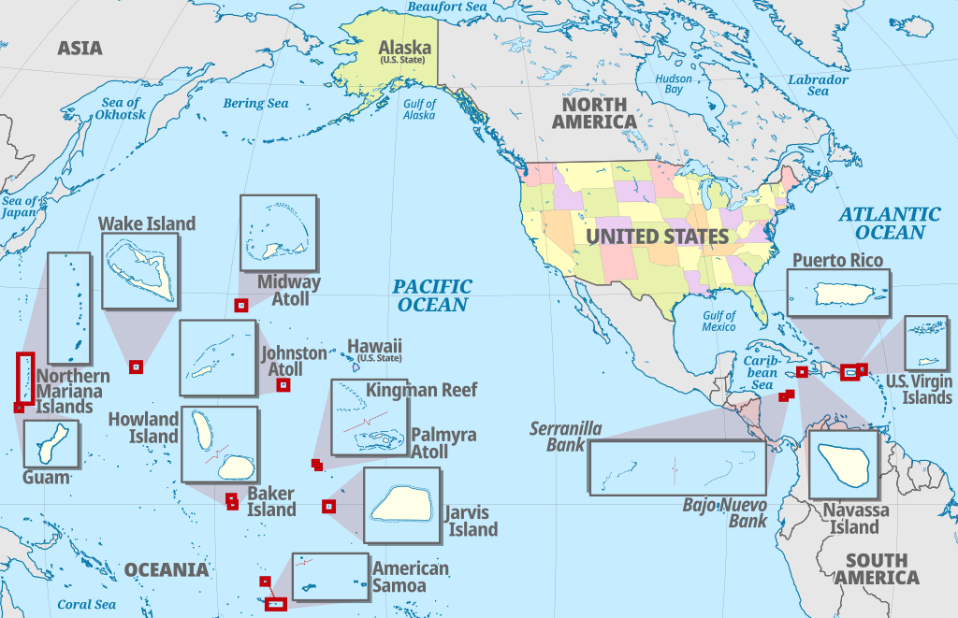
U.S. Territories

Slide 28
International Law
Each nation has its own set of national laws.
  Laws differ significantly between nations.
  Each nation has its own ideas about:
    Sovereignty
    National interests
    Cultural values
    Religion
    Economy
    Borders

Slide 29
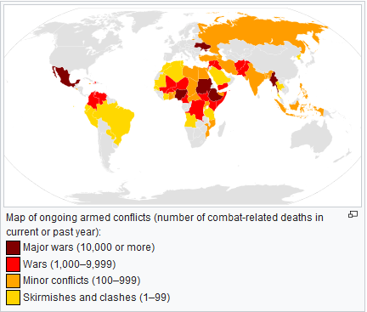
International Law
Conflict between and within nations often arises due to:
  Trade imbalances
  Economic threats
  Religious differences
  Famine
  Disease control
  Terrorism
  Human rights issues
  Refugees
May result in war.

Slide 30
International Law
International Law is applied to resolve and discourage conflict through:
  International Conventions and Treaties
  Customary International Law
  General Principles of Law
  Comity of Nation
    The courtesy and friendship of nations marked especially by mutual recognition of executive, legislative, and judicial acts.

Slide 31
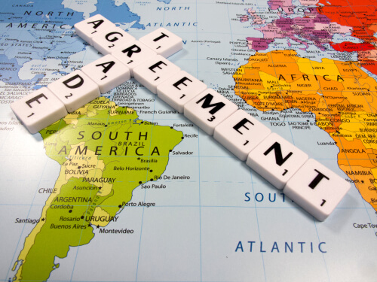
International Law
International Conventions and Treaties
  Formal pledges between nations.
  Treaties:
    Written agreement signed by countries or organizations.
    Ratified by the United Nations.
    Governed Vienna Convention on the Laws of Treaties (VCLT).
  Conventions:
    Consensus regarding how to approach global issues.

Slide 32
International Law
Customary International Law
  Long standing rules.
  General practice accepted as law.
  Practice must be accepted as opinio juris sive necessitates (Latin: “opinion that an act is necessary by rule of law”).
  Difficult to enforce between West and East.
  Example:
    Immunity of visiting foreign heads of state.
    Non-refoulement – asylum seeker protection.

Slide 33
International Law
General Principles of Law.
  Legal principles common to a large number of systems of law.
  General principles "recognized" by states.
  Lessened by increased intensity of treaties between states.
  Example:
    Right for nation to defend itself.

Slide 34
International Law
Comity of Nations
  Courtesy and friendship of nations
  Mutual recognition of
    Executive
    Legislative
    Judicial acts
  Basically accepting each other’s laws
  Example:
    Nintendo vs Danny Chu, Aeropower Company – U.S. court awarded Nintendo damages against two Taiwanese nationals for trafficking in counterfeit Donkey Kong, Super Mario Bros. and dozens of other Nintendo games.

Slide 35
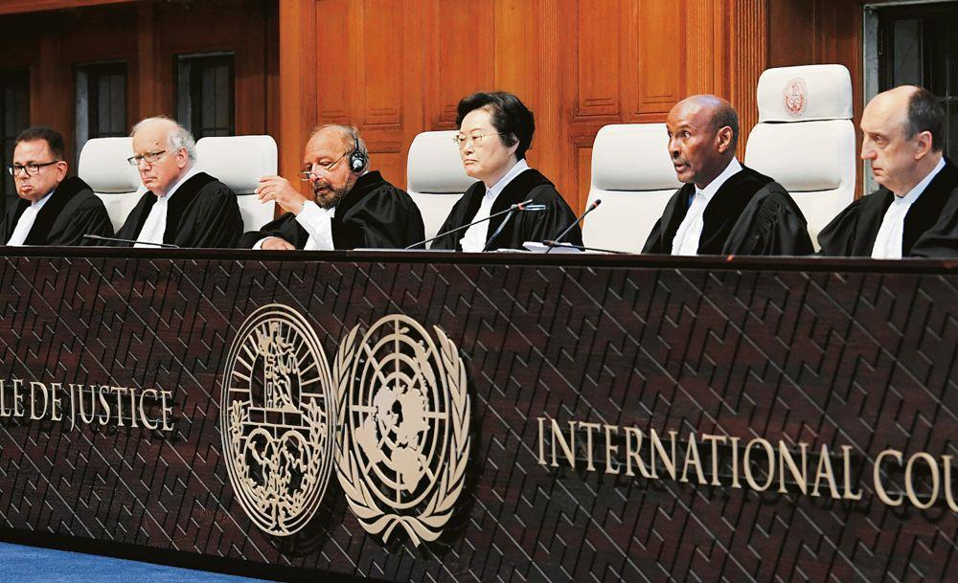
International Law
International Court of Justice.
  Judicial organ of the United Nations.
    Settles international disputes.
    Provides advisory options on legal questions.
    Only nations may be tried by this court
    Will only try cases when both nations agree to accept judgement.

Slide 36
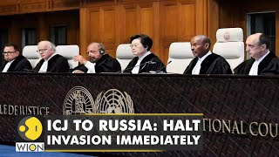
International Law
International Court of Justice Enforcement.
  Difficult to enforce.
    Embargoes.
    Retorsion - high tariffs and discriminatory duties.
    Reprisal – illegal action made legal – such as seizing property.
    War – last resort.

Slide 37

International Law
INTERPOL - International Criminal Police Organization.
  Worlds largest police organization.
  Supports national law agencies to fight international crimes.
  Forensic database (DNA and fingerprints).
Combats international crimes such as:
  Terrorism.
  Financial crimes.
  Human Trafficking.
  Drug Trafficking.
  Art theft.
  Intellectual property crimes.

Slide 38
International Trade
US and China Tariffs:
  March 22, 2018 US imposes $50 billion tariffs on Chinese goods.
    Imposed due to Chinese theft of U.S intellectual property.
    Would make United States "a much stronger, much richer nation”.
  The Dow Jones Industrial Average fell 724 points.
  China announces plans to implement its own tariffs.
  April 2, 2018 – China imposes tariffs on 128 U.S. products.
  April 3, 2018, U.S publishes initial list of 1,300+ Chinese good for tariff.
  April 4, 2018, China announces additional tariffs of 25% on 106 items.

Slide 39
International Trade
US and China Tariffs
  April 4, 2018, President Trump responded, "We are not in a trade war with China, that war was lost many years ago by the foolish, or incompetent, people who represented the U.S. Now we have a Trade Deficit of $500 Billion a year, with Intellectual Property Theft of another $300 Billion. We cannot let this continue!“
  May 9, 2018, China cancels soybean orders exported from US.
  June 15, 2018, US releases list of $34 billion of Chinese goods 25% tariff.
  July 6, 2018 US releases list of $16 billion of Chinese goods 25% tariff with August 23 start.
  July 10, 2018 US releases new list of $200 billion with 10% tariff.

Slide 40
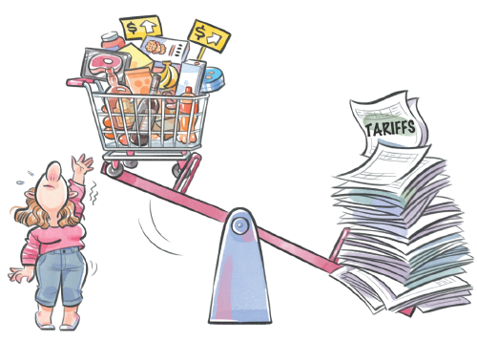
International Trade
US and China Tariffs
  In 2018 China ended its domestic ownership rules for auto companies and financial institutions.
  The rules required that auto companies and financial institutions in China be at least 50 percent owned by Chinese companies.
  The change was seen as benefitting U.S. auto companies including Tesla.

Slide 41
International Trade
US and China Tariffs
  Short term benefits and costs?
  Long term benefits and costs?

Slide 42
International Trade
Requirement 4b – International Trade -Homework
  Using resources such as major daily newspapers, the Internet (with your parent’s permission), and news magazines, observe a current issue that involves international trade, foreign exchange, balance of payments, tariffs, and free trade. Explain what you have learned. Include in your discussion an explanation of why countries must cooperate in order for world trade and global competition to thrive.

Slide 43
International Organizations
4c. Select TWO of the following organizations and describe their role in the world.
(1) The United Nations and UNICEF
(2) The World Court
(3) Interpol
(4) World Organization of the Scout Movement
(5) The World Health Organization
(6) Amnesty International
(7) The International Committee of the Red Cross
(8) CARE (Cooperative for American Relief Everywhere)
(9) European Union

Slide 44

International Organizations
United Nations
  Intergovernmental organization that aims to maintain
    International peace and security
    Develop friendly relations among nations
    Achieve international cooperation
    Center for harmonizing the actions of nations
  Largest, most familiar, most internationally represented and most powerful intergovernmental organization in the world

Slide 45

International Organizations
United Nations Children's Fund - UNICEF
  United Nations agency responsible for providing humanitarian and developmental aid to children worldwide
  1946 International Children’s Emergency Fund (ICEF)
    Provide relief to children and mothers affected by World War II
  2018
    Assisted in the birth of 27 million babies
    Administered vaccines to an estimated 65.5 million children
    Provided education for 12 million children
    Treated four million children with severe acute malnutrition

Slide 46

International Organizations
The World Court - International Court of Justice (ICJ)
  Settles disputes between states.
  Gives advisory opinions on international legal issues.
  Its opinions and rulings serve as sources of international law.
  International Court of Justice is the most supreme court in the world.

Slide 47

International Organizations
INTERPOL - International Criminal Police Organization
  Facilitates worldwide police cooperation and crime control
  Seven regional bureaus worldwide
  a National Central Bureau in all 194 member states
  World’s largest police organization
  Focuses on three major areas of transnational crime:
    Terrorism
    Cybercrime
    Organized crime

Slide 48

International Organizations
WOSM - World Organization of the Scout Movement.
  Established in 1922.
  Largest international Scouting organization.
  171 members.
    Collectively have over 50 million participants.
  The World Scout Jamboree is held roughly every four years.
  World Scout Moot - senior branches and other young adult members.
  World Scout Indaba - gathering for Scout leaders.
  The World Scout Foundation – development of Scouting programs throughout world.

Slide 49

International Organizations
Amnesty International
  Non-governmental organization
  Headquartered in the United Kingdom
  Key areas Amnesty focuses on:
    Women's, children's, minorities' and indigenous rights
    Ending torture
    Abolition of the death penalty
    Rights of refugees
    Rights of prisoners of conscience
    Protection of human dignity

Slide 50

International Organizations
ICRC - The International Committee of the Red Cross
  2005 - mandate to protect victims of armed conflicts.
    War wounded
    Prisoners
    Refugees
    Civilians
    Other Non-combatants

Slide 51

International Organizations
CARE (Cooperative for American Relief Everywhere)
  Major international humanitarian agency.
  One of the largest and oldest aid organization fighting poverty.
  Broad range of topics including:
    Emergency response
    Food security
    Water and sanitation
    Economic development
    Climate change
    Agriculture, education, and health

Slide 52

International Organizations
European Union
  Political and economic union of 27 member state (477 million people)
  Internal single market through a standardized system of laws
  Free movement of people, goods, services and capital
  Has been described as an emerging superpower
  States maintain independence
    Own armed forces
    Ability to tax
    Ability to withdraw from union

Slide 53
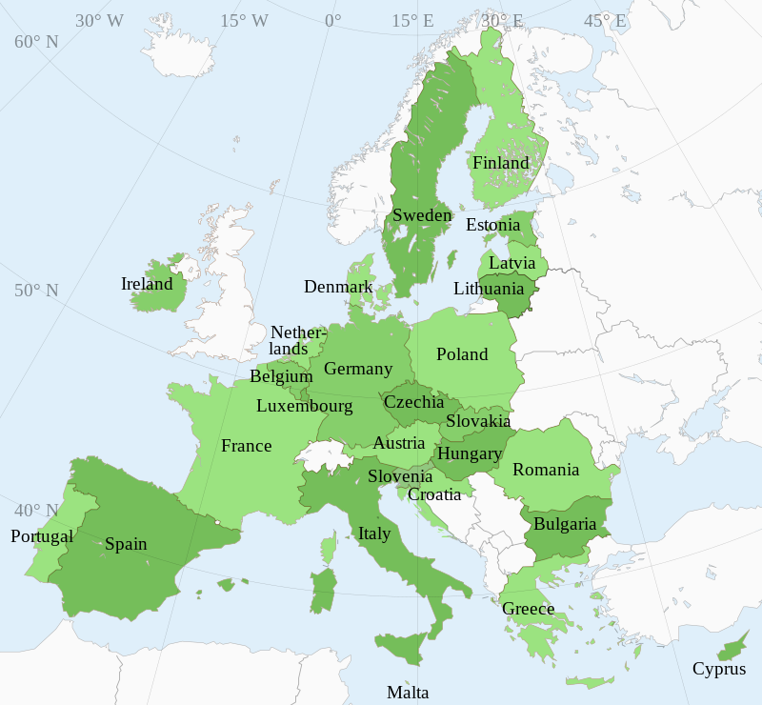
European Union

Slide 54
Requirement 5
Do the following:
  Discuss the differences between constitutional and nonconstitutional governments.
  Name at least five different types of governments currently in power in the world.
  Show on a world map countries that use each of these five different forms of government.

Slide 55
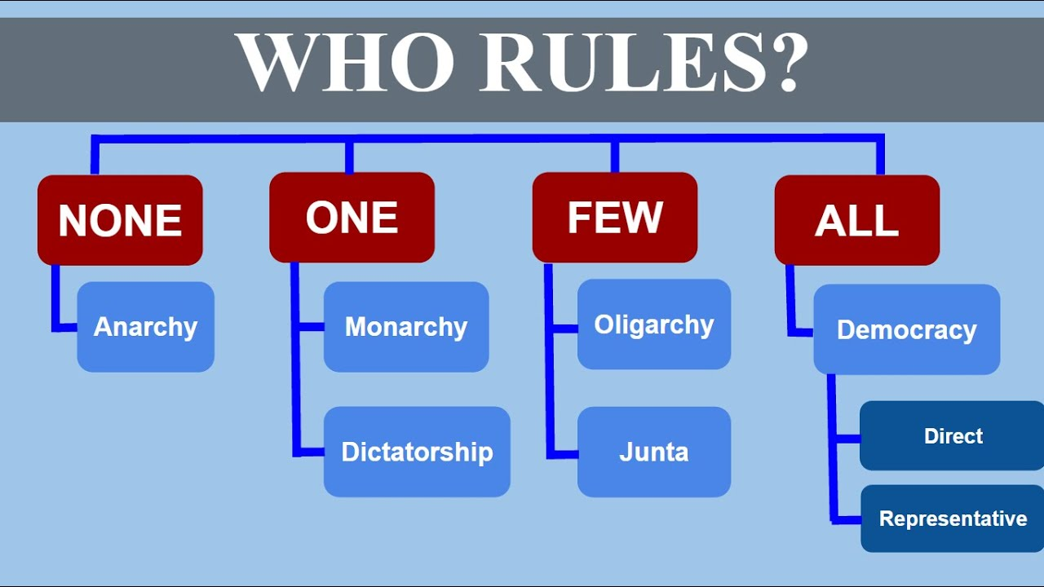
Governments
5a. Discuss the differences between constitutional and nonconstitutional governments.

Slide 56
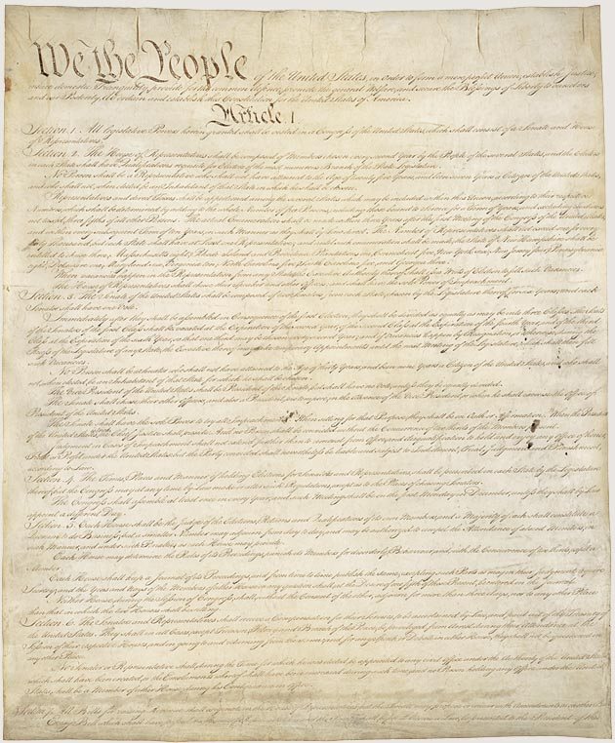
Governments
Constitutional Law
  Defines role, powers and structure of government
    Rights of Citizens
    Rule of Law
    Separation of Powers – limits of governmental power
    Humanitarian rights (optional)

Slide 57
Governments
Countries with a Constitution
  United States
  United Kingdom (Uncodified)
  India
  Singapore
  Nazi Germany
  China
  North Korea

Slide 58
Governments
“Constitutional Government”
  A Constitutional Government is more than having a constitution
    de jure systems of government (legally recognized)
    de facto systems of government (in practice)

Slide 59
Governments
For the purposes of this merit badge “Constitutional Government” has:
  Limited Power
  Higher Law
  Constitutional Stability

Slide 60
Governments
Limited Power
  Rule of Law applies to everyone.
  Government and Officers have limits to power:
    Separation of powers.
    Checks and Balances.
  Provision to remove officers if laws are violated.

Slide 61
Governments
Higher Law
  Constitution is HIGHEST LAW.
  Individual rights are protected from infringements by government.
    i.e. - Protection from illegal search and seizures.

Slide 62
Governments
Constitutional Stability
  Constitution can not be changed without consent of citizens.
  Must use well-known established amendment procedures.

Slide 63
Governments
Examples of “Constitutional Governments”:
  United States of America
  United Kingdom
  Taiwan
  Japan
  France

Slide 64
Governments
“Nonconstitutional Government”
  Authoritarian Governments.
    Autocratic leader or oligarchy (ruling group).
    Unrestrained power – not bound by constitution.
    Remains in control for as long and desires – or overthrown.
    Often tyrannical rule.
      Controls every aspect of life.
      Keeps citizens in line.
      Very oppressive.
    May be benevolent king/dictator.

Slide 65
Governments
Types of Rule:
  Rule can be through inheritance, revolution, election, merit, wealth.
    Autocracy - Rule by One.
    Oligarchy - Rule by Few.
    Democracy - Rule by Many.
    Republic - Rule by Representation.
    Anarchy - Rule by None.

Slide 66
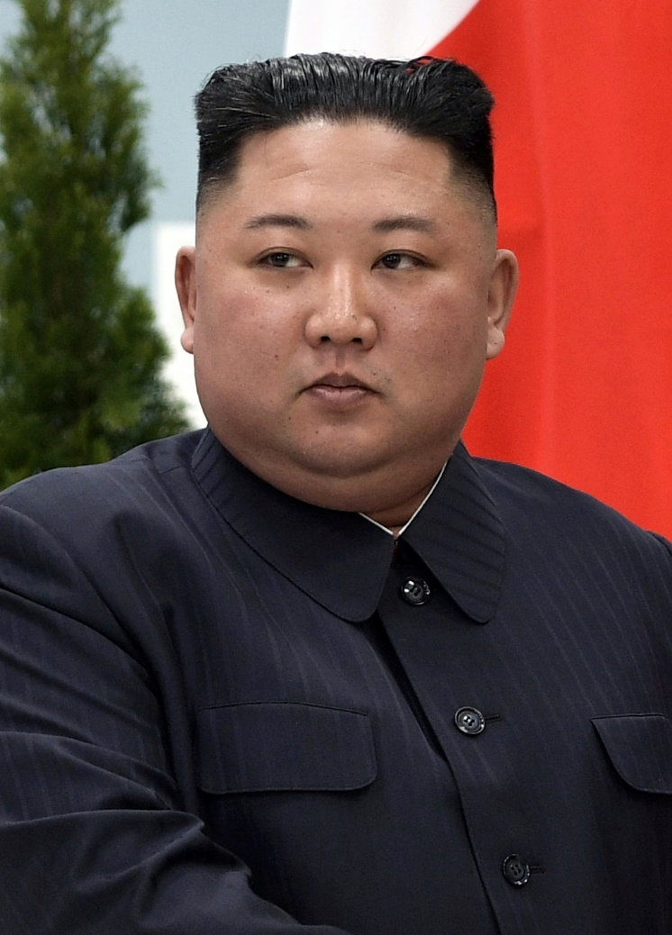
Governments
Types of Rule:
  Autocracy – Rule by One
    Monarch – Salman bin Abdulaziz Al Saud (Saudi Arabia)
    Dictator – Kim Jong-un (North Korea)
    Military Leader – Prayut Chan-o-cha (Thailand) till 2014-2019
    Religious Leader – Tenzin Gyatso (Tibet) 1937-1950
Kim Jong-un (North Korea)

Slide 67
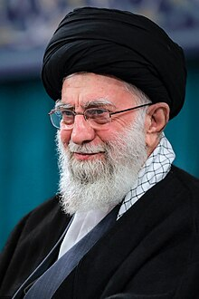
Governments
Types of Rule:
  Oligarchy – Rule by Few.
    Single Political Party – China 1949-.
    Military Group (Junta) – Chili 1973-1990.
    Religious Elite (Ayatollah) – Iran 1979-.
    Ethnic Minority - Rhodesia 1965-1979.
Ayatollah Ali Khamenei

Slide 68
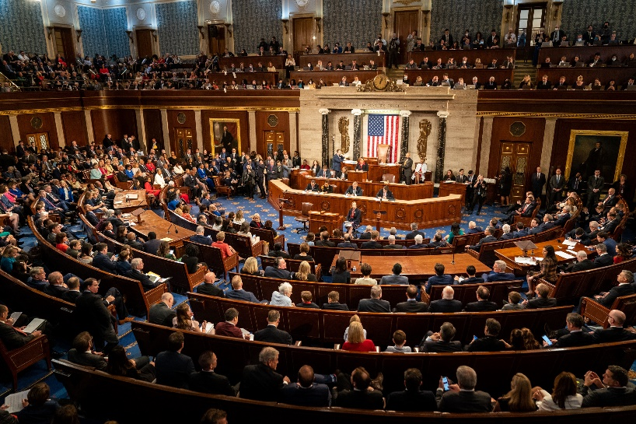
Governments
Types of Rule:
  Representative Democracy – Rule by Representation.
    Roman Republic 509 BC to 27 BC.
      All free citizens share power to elect magistrates and pass laws.
    US
      Federal republic.
      Elected officials.
U.S. Congress

Slide 69
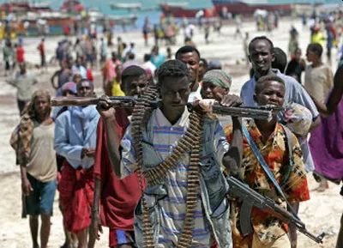
Governments
Types of Rule:
  Anarchy – Rule by None.
    Self governance.
    Individuals able to live free from governmental constraints.
    Significant security concerns.
    Somalia 1991 to 2006.
Somalia Anarchy

Slide 70
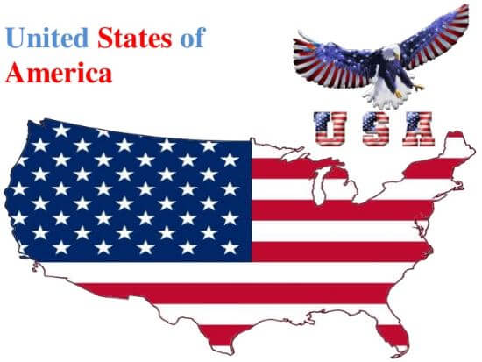
Governments
Government Types:
  Presidential Republic
    Head of state is executive.
    Presidency is independent of legislature.
    Ministry is independent of legislature.

Slide 71
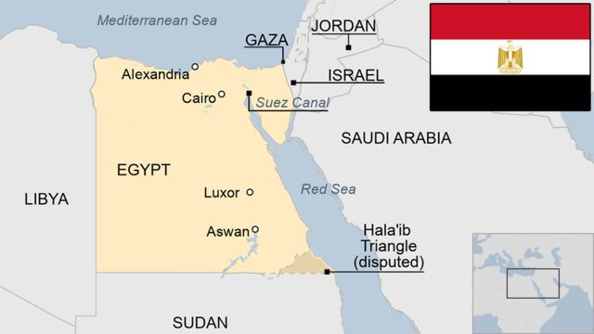
Governments
Government Types
  Semi-presidential republic:
    Head of state is executive.
    Presidency is independent of legislature.
    Ministry is subject to parliamentary confidence.

Slide 72
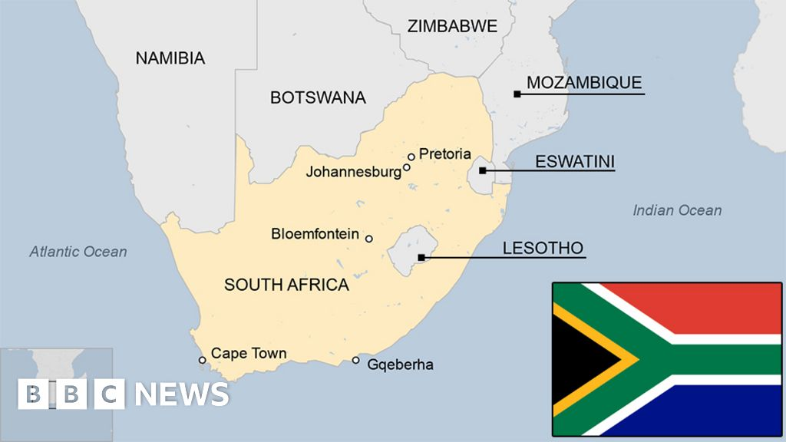
Governments
Government Types
  Republic with an executive presidency nominated by or elected by the legislature:
    President is both head of state and government.
    Ministry, including the president, may or may not be subject to parliamentary confidence.

Slide 73
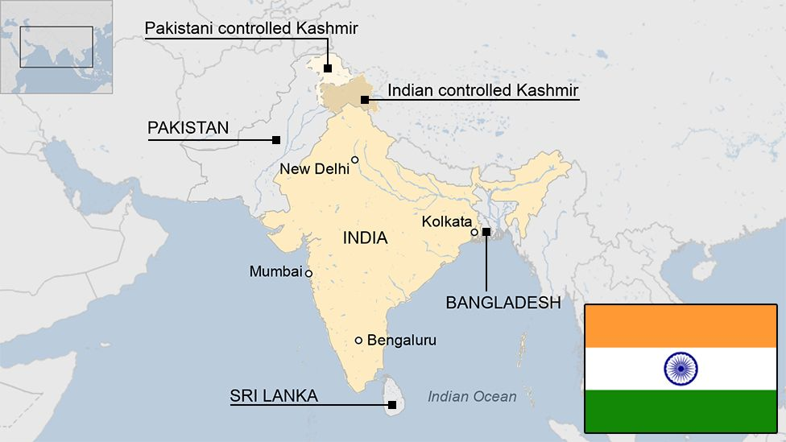
Governments
Government Types
  Parliamentary republic with a ceremonial presidency:
    Head of state is ceremonial.
    Ministry is subject to parliamentary confidence.

Slide 74
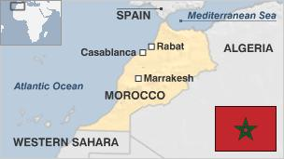
Governments
Government Types
  Constitutional monarchy:
    Head of state is executive.
    Monarch personally exercises power in concert with other institutions.

Slide 75
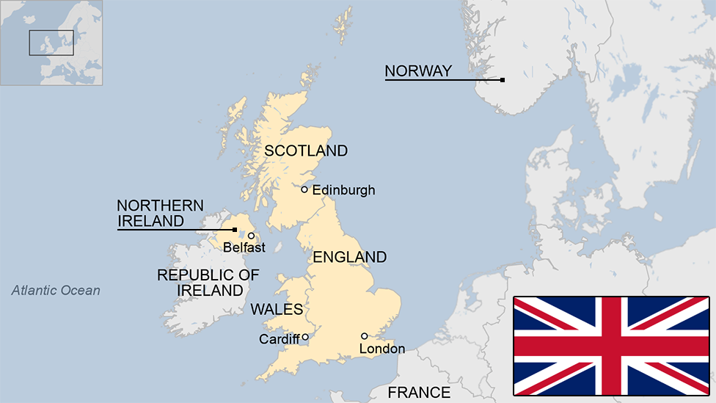
Governments
Government Types
  Constitutional parliamentary monarchy:
    Head of state is ceremonial
    Ministry is subject to parliamentary confidence

Slide 76
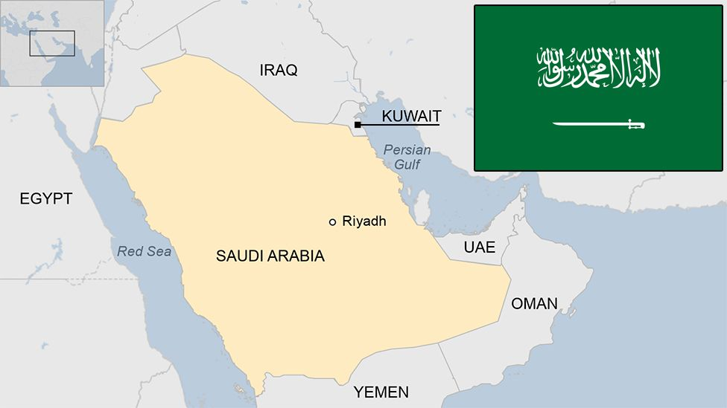
Governments
Government Types
  Absolute monarchy:
    Head of state is executive
    All authority vested in absolute monarch

Slide 77
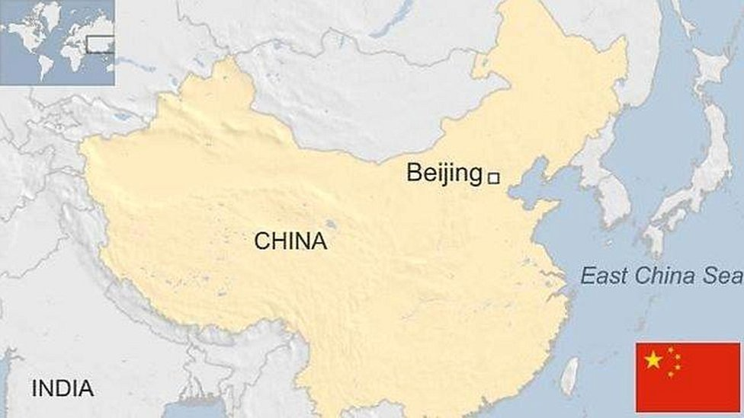
Governments
Government Types
  One-party state:
    Head of state is executive
    Power constitutionally linked to a single political movement

Slide 78
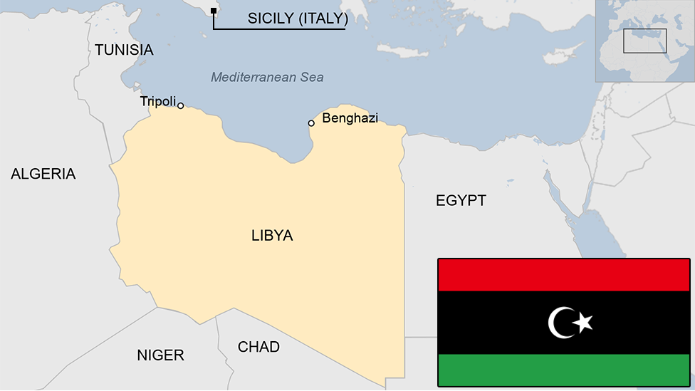
Governments
Government Types
  No constitutionally defined basis to current regime
    No legally written system

Slide 79
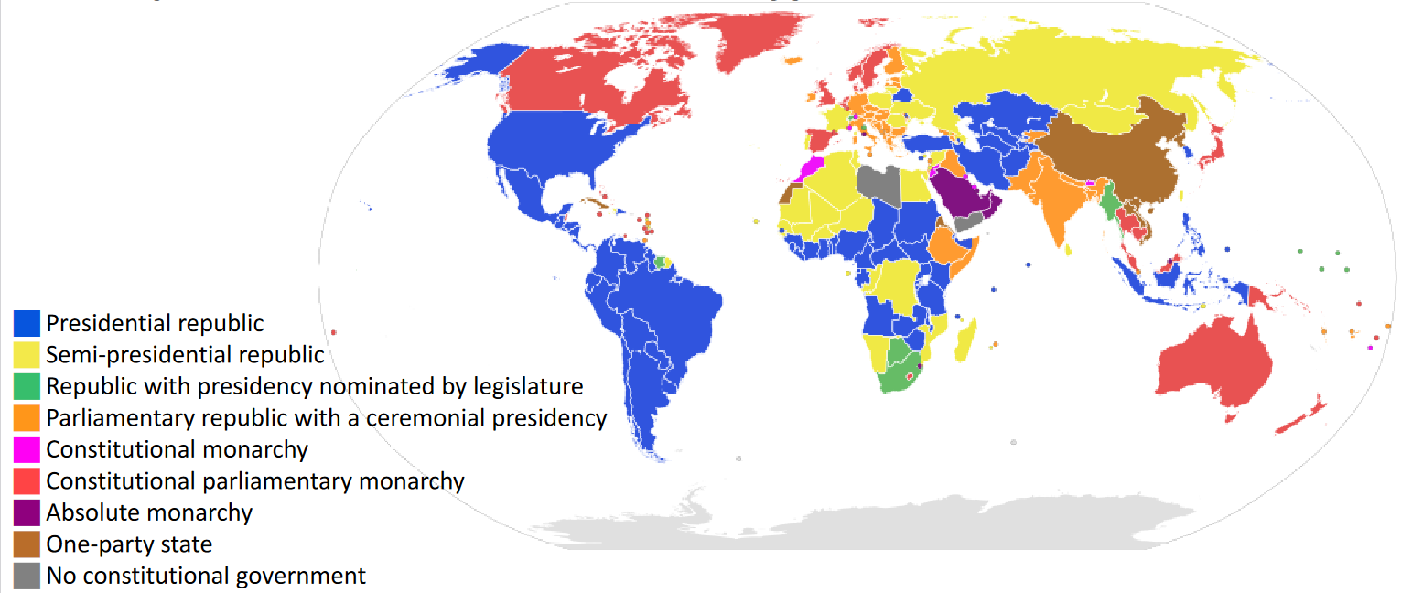
Governments

Slide 80
Requirement 6
Do the following:
  Explain how a government is represented abroad and how the United States government is accredited to international organizations.
  Describe the roles of the following in the conduct of foreign relations.
    Ambassador
    Consul
    Bureau of International Information Programs
    Agency for International Development
    United States and Foreign Commercial Service
  Explain the purpose of a passport and visa for international travel.

Slide 81
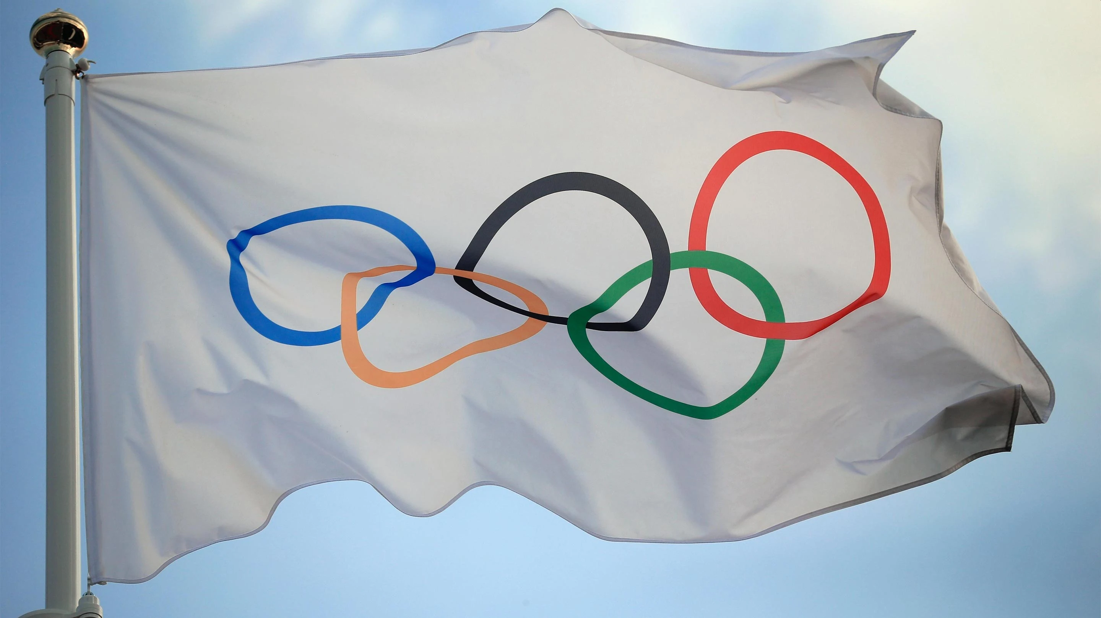
National Recognition
National Representation
  There are many ways a nation represents itself in the world.
    Maintaining presence in foreign countries.
    Participation in intergovernmental organizations.
      United Nations.
      International Atomic Energy.
    International Events.
      Olympics.

Slide 82

National Recognition
National Representation
  There are many ways a nation represents itself in the world.
    U.S. Department of State (DoS).
      ‘Promoting peace and stability in regions of vital interest’.
      ‘Creating jobs at home by opening markets abroad’.
      ‘Helping developing nations establish investment and export opportunities’.
      ‘Bringing nations together and forging partnerships to address global problems, such as terrorism, the spread of communicable diseases, cross-border pollution, humanitarian crises, nuclear smuggling, and narcotics trafficking’.

Slide 83

National Recognition
National Representation
  There are many ways a nation represents itself in the world.
    U.S. Department of State (DoS).
      Provides direct advice to the president.
      Supports foreign policy programs in US governmental organizations.
        Office of Global Programs and Initiatives.
        Fulbright U.S. Student Program.
        Peace Corps (Separate from DoS).
        U.S. Agency for International Development (Separate from DoS).

Slide 84
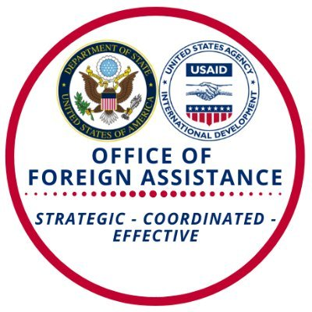
National Recognition
National Representation
  There are many ways a nation represents itself in the world.
    U.S. Department of State.
      Office of Foreign Assistance.
        Security Assistance.
        Economic and Development Assistance.
        Humanitarian Assistance.

Slide 85

National Recognition
National Representation
  There are many ways a nation represents itself in the world.
    U.S. Department of Defense.
      Responding to humanitarian and basic needs.
      Building foreign military capacity and capabilities.
      Strengthening foreign governments’ ability to deal with threats.

Slide 86
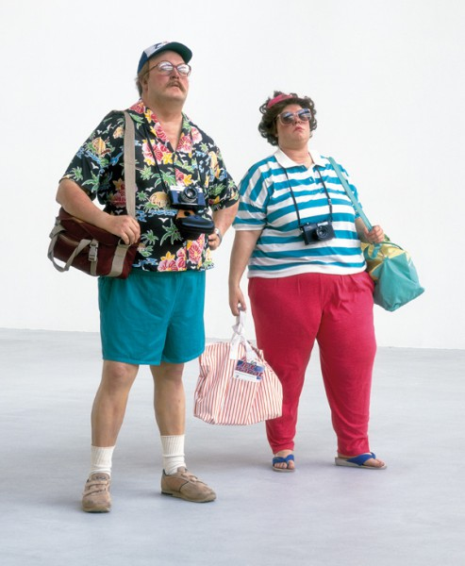
National Recognition
National Representation
  There are many ways a nation represents itself in the world.
    Nongovernmental presence also represents your nation.
      Tourists.
      Students.
      Businesspeople.
      Artists.
      Nongovernmental organizations.
      Activists.

Slide 87
National Recognition
National Representation
  How is the U.S. government is accredited to international organizations?
    U.S. government sends and received diplomatic representative.
    The Head of State appoints people to serve as diplomats.
    They are Accredited to foreign country or organization of assignment.
      Allows them to be legally recognized as diplomat from U.S.
      Credentials are presented to foreign government or governing body.
      Formal letters stating diplomat is official designate for Head of State.

Slide 88
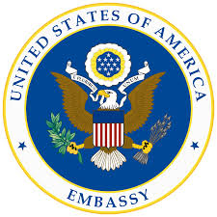
National Recognition
National Representation
  Ambassador
    The ranking government representative stationed in a foreign capital.
    Host country typically allows the ambassador control of embassy.
      Territory, staff, and vehicles generally afforded diplomatic immunity.
    Ambassador must be Accredited and accepted by Host Nation.
    A Host Nation may reverse approval of an Ambassador.
      Declares the diplomat a persona non grata (unacceptable person).
      Declaration usually results in recalling the ambassador.
      This is a harsh action and may lead to war.

Slide 89

National Recognition
National Representation
  Consul
    An official appointed by a government to reside in a foreign country and represent its interests there.
    The consul is generally the head of the consular section of an embassy.
      Responsible for all consular services.
        Immigrant and non-immigrant visas.
        Passports.
        Citizen services for expatriates living/traveling in host country.

Slide 90

National Recognition
National Representation
  Bureau of International Information Programs.
    Supports the Department of State’s public diplomacy.
    “provides and supports the places, content, and infrastructure needed for sustained conversations with foreign audiences to build America's reputation abroad”.
      Over 700 American Spaces around the world.
      Social media community with over 12 million followers.

Slide 91
National Recognition
National Representation
  Agency for International Development aka USAID.
    Advances U.S. national security and economic prosperity.
    Demonstrates American generosity.
    Promotes a path to recipient self-reliance and resilience.
      Agriculture and Food Security
      Democracy, Human Rights and Governance
      Economic Growth and Trade
      Education
      Environment and Global Climate Change
      Gender Equality and Women’s Empowerment
      Global Health
      Humanitarian Assistance
      Water and Sanitation
      Working in Crisis and Conflict
      U.S. Global Development Lab

Slide 92
National Recognition
National Representation
  United States and Foreign Commercial Service.
    U.S. Department of Commerce's International Trade Administration.
    Mission of CS is to advance and protect strategic U.S. commercial and economic interests around the world.
    Helps thousands of U.S. companies to export goods and services.
      Broadening and deepening the U.S. exporter base.
      Removing obstacles to export success of U.S. small/med companies.
      Advancing U.S. business interests around the world.
      Attracting foreign direct investment.
      Supporting job creation throughout the United States.

Slide 93
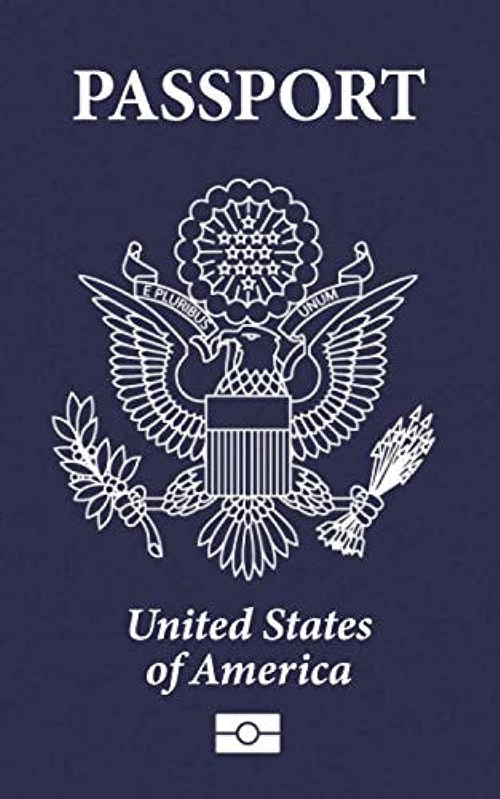
National Recognition
National Representation
  Purpose of a passport for international travel.
    Issued by government affirming individual’s nationality.
    Certifies the identity and nationality of its holder.
    A passport does not of itself create any rights in the country visited.
    International custom and treaties may allow for:
      Safe passage.
      Lawful aid.
      Protection while under a foreign government’s jurisdiction.

Slide 94
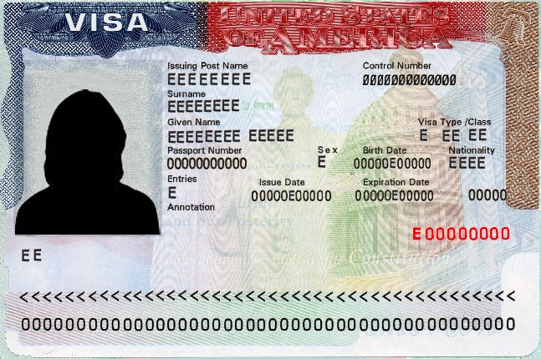
National Recognition
National Representation
  Purpose of a visa for international travel.
    Conditional authorization granted by a territory to a foreigner, allowing:
      Foreigner to enter.
      To remain within.
      To leave that territory.
    Typically include limits on:
      Duration of the foreigner's stay.
      Areas within the country they may enter.
      Dates they may enter.
      Number of permitted visits.

Slide 95
Requirement 7
Do TWO of the following (with your parent's permission) and share with your counselor what you have learned:
  Visit the website of the U.S. State Department. Learn more about an issue you find interesting that is discussed on this website.
  Visit the website of an international news organization or foreign government, OR examine a foreign newspaper available at your local library, bookstore, or newsstand. Find a news story about a human right realized in the United States that is not recognized in another country.
  Visit with a student or Scout from another country and discuss the typical values, holidays, ethnic foods, and traditions practiced or enjoyed there.
  Attend a world Scout jamboree.
  Participate in or attend an international event in your area, such as an ethnic festival, concert, or play.

Slide 96

Requirement 7
Visit the website of the U.S. State Department.
Learn more about an issue you find interesting that is discussed on this website.

Slide 97
Requirement 7
Visit the website of an international news organization or foreign government, OR examine a foreign newspaper available at your local library, bookstore, or newsstand.
Find a news story about a human right realized in the United States that is not recognized in another country.
Example: Uyghurs in China
  Counter-Terrorism Law of the People’s Republic of China and its Regional Implementing Measures, the 2016 Xinjiang Uyghur Autonomous Region Implementing Measures OL CHN 18/2019. UN
  The Uighurs and the Chinese state: A long history of discord BBC. UK
  New research reveals absurd rumor sources of Uyghur detentions in Xinjiang endeared by Western media Global Times. China
  Xinjiang critics misguided China Daily. China

Slide 98
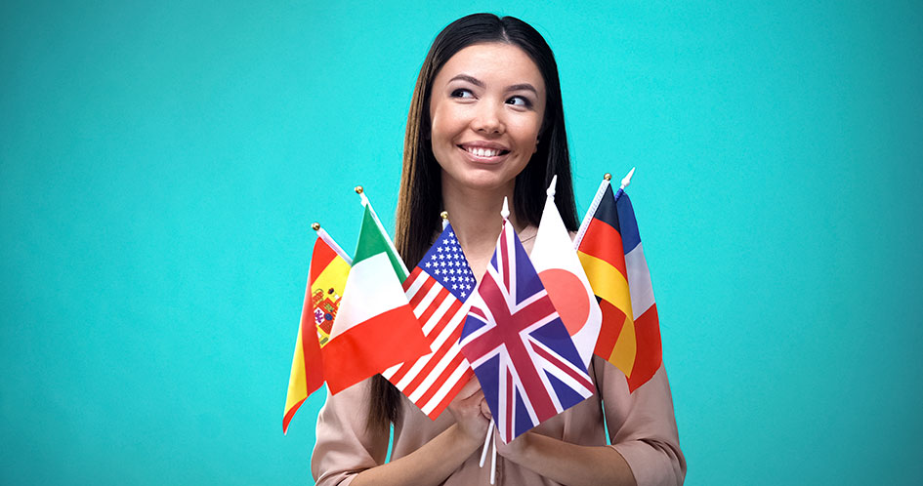
Requirement 7
Visit with a student or Scout from another country and discuss the typical values, holidays, ethnic foods, and traditions practiced or enjoyed there.
i.e. Foreign exchange students in your school.

